Slide 1

Blockchain
Sunitha R
Department of Computer Science and Engineering

Slide 2

Blockchain
Consensus Algorithms-II
Sunitha R
Department of Computer Science and Engineering

Slide 3
Blockchain
Objectives
Agreement
Termination
Validity
Fault tolerant
Integrity

Slide 4
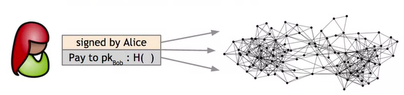
Blockchain
How does Consensus work?
Alice wants to pay Bob.
Alice broadcasts the transaction to all nodes.
All the nodes need to agree the correctness of this transactions.
Each node has set of outstanding transactions it’s heard about
Courtesy: https://www.coursera.org/learn/cryptocurrency
.

Slide 5
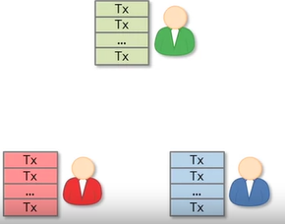
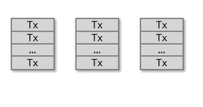
Blockchain
How does Consensus work?
Miners

Slide 6
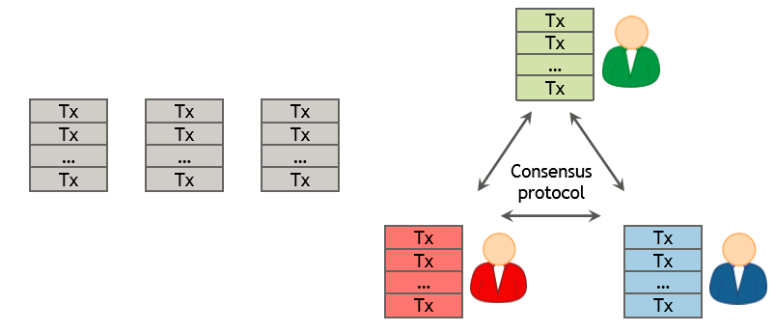
Blockchain
How does Consensus work?

Slide 7

Blockchain
How does Consensus work?

Slide 8

Blockchain
Consensus Algorithm
Courtesy: https://www.coursera.org/learn/Blockchain-basics/

Slide 9
Blockchain
Consensus Algorithm
Why consensus is hard?
Nodes may crash
Nodes may be malicious
Network is imperfect
Not all pairs of nodes connected
Faults in network
Latency

Slide 10
Blockchain
Types of Consensus Algorithms
Proof of Work (PoW)
Proof of Stake (PoS)
Delegated Proof of Stake (Dpos)
Proof of Authority
Proof of Elapsed Time
Proof of Scope
Proof of Space
Proof of Burn
RAFT
PAXOS
Byzantine Fault Tolerance System
PBFT.

Slide 11
Blockchain
Fault Tolerent
Crash Fault Tolerance: Paxos
RAFT
Byzantine Fault Tolerance: BFT
PBFT

Slide 12
Blockchain
How can you choose the right consensus protocol for your Blockchain?
The speed in which your blocks will need to be written into the Blockchain?
What type of network will you be using?
How many miners, writers, or validators do you think you will need?
How “final” does a block need to be?
To what degree do you put your trust in the nodes/operators?

Slide 13
Blockchain
How can you choose the right consensus protocol for your Blockchain?
Permissioned Blockchain
Depends on factors like the extent of decentralization required, how much the participants in a network trust each other, the number of permissions that must be granted.
Eg:Practical byzantine fault tolerance and its variants
Permissionless Blockchain
PoW, PoET
it is crucial to choose the right consensus model for your specific Blockchain.

Slide 14
Blockchain
Supplementary readings
https://www.coursera.org/learn/cryptocurrency
https://www.coursera.org/learn/Blockchain-basics/
https://www.youtube.com/watch?v=3xGLc-zz9cA

Slide 15
THANK YOU
Prof.Sunitha R
Department of Computer Science and Engineering
sunithar@pes.edu

